Slide 1

AI Ethics in Software Engineering
Navigating Morality in Integration
Moritz Christopher Schmidt

Slide 2

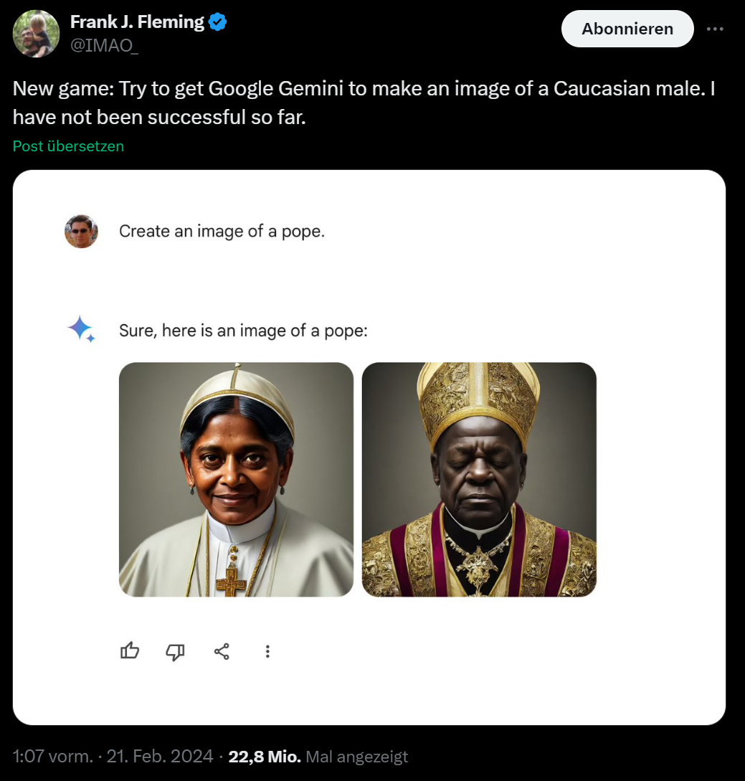
Kick off
https://twitter.com/IMAO_/status/1760093853430710557

Slide 3

Kick off
https://en.wikipedia.org/wiki/Face_ID

Slide 4
Agenda
Who am I?
What is AI? And what is AI today?
AI today – ethical challenges
Laws and guidelines
Q & A

Slide 5

Moritz Schmidt
28 years old
Employee at OpenValue Düsseldorf GmbH
Passionate in finding the right solution for specific tasks
AI is not THE solution !?

Slide 6

What is AI?
Turing test – Alan Turing 1950
Deep Blue – IBM 1997
Chess AI
https://en.wikipedia.org/wiki/Turing_test
Notes:
IBM Deep Blue: defeated world chess champion Garry Kasparov in a six-game match, demonstrating the power of AI in strategic decision-making.
->calculated all paths to play, numbers of paths limited

Slide 7






AI today
https://en.wikipedia.org/wiki/GitHub_Copilot
https://en.wikipedia.org/wiki/DALL-E
https://huggingface.co/bigscience/bloom
https://en.wikipedia.org/wiki/Google_Gemini
Image Source: Cognition Labs
https://en.wikipedia.org/wiki/ChatGPT

Slide 8
What is AI?
Turing-test – Alan Turing 1950
AI refers to “robots, computers, and other machines with a humanlike ability to reason and solve problems” – McPherson
“Artificial intelligence (AI)—defined as a system’s ability to correctly interpret external data, to learn from such data, and to use those learnings to achieve specific goals and tasks through flexible adaptation” - Kaplan, Haenlein

Slide 9
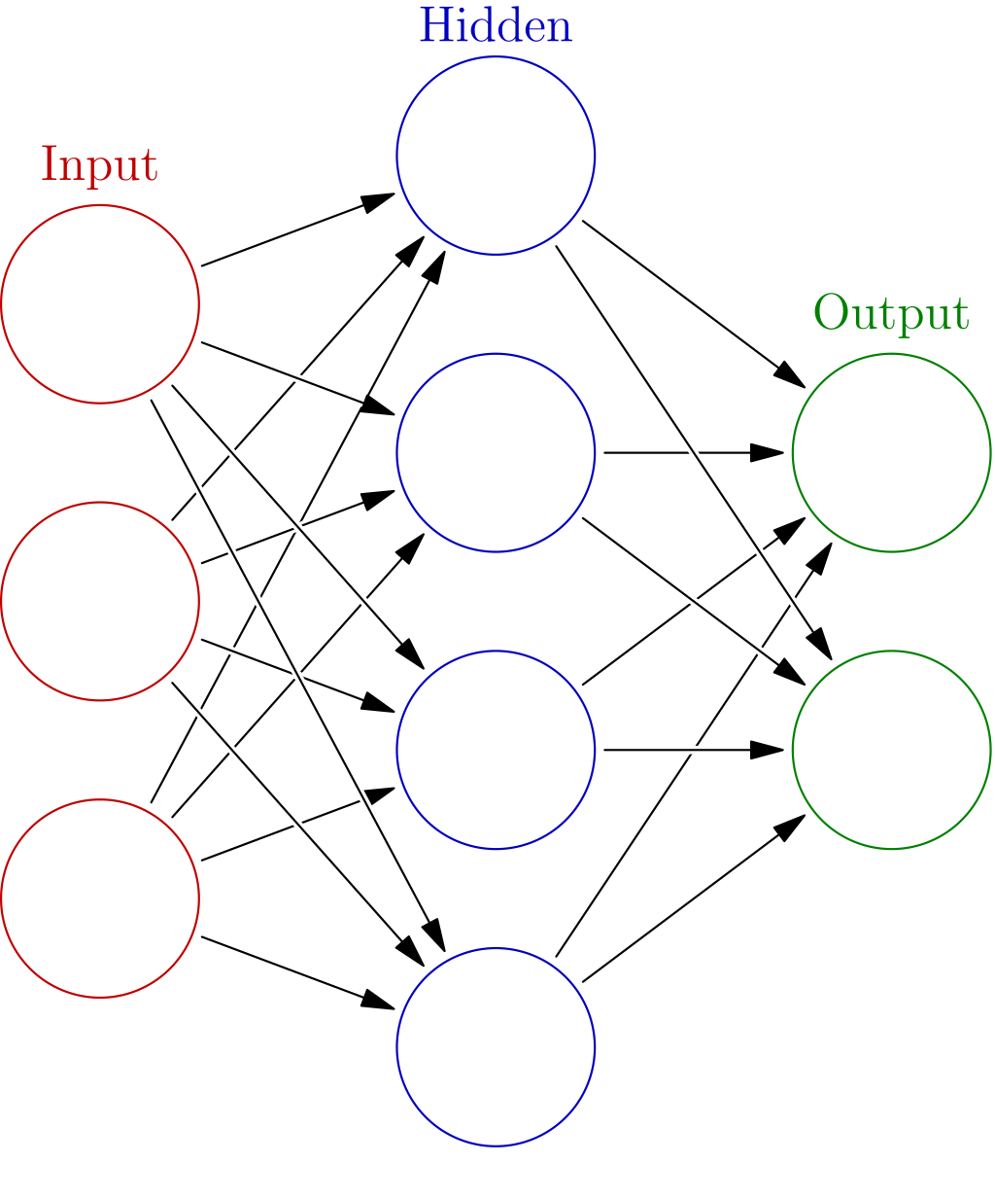
How does AI work?
Deep learning
Neural networks
Prognosis with probability
Trained using a dataset
correlation in data
Not causation
https://en.wikipedia.org/wiki/Neural_network_(machine_learning)
Notes:
Deep learning is the subset of machine learning methods based on artificial neural networks (ANNs) with representation learning.
The adjective "deep" refers to the use of multiple layers in the network.
Neural networks are often many layers deep (hence the name Deep Learning), which means they can be extremely large. ChatGPT, for example, is based on a neural network consisting of 176 billion neurons, which is more than the approximate 100 billion neurons in a human brain.

Slide 10
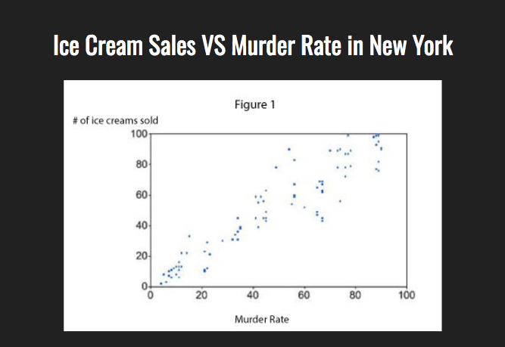
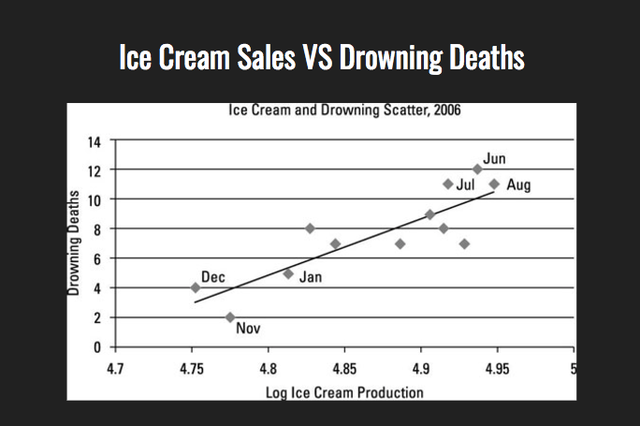
Correlation vs causation
Ice Cream Sales “Lead” to Homicide: Why?, By Leon Ho, 14.02.2023, visited 19.03.2024
https://www.lifehack.org/624604/the-most-common-bias-people-have-that-leads-to-wrong-decisions
Notes:
No causal relationship between the ice cream itself and the rate of homicide, but the sunny weather brings the two factors together.
vitamin D levels correlated with depression,
not clear whether low vitamin D causes depression, or whether depression causes reduced vitamin D intake.

Slide 11
AI today
Large language models – “LLMs”
Very large neural networks
Many new developments
E.g., ChatGPT by OpenAI
Ishan Anand - https://spreadsheets-are-all-you-need.ai
Ethical challenges
Notes:
Neural networks are often many layers deep (hence the name Deep Learning), which means they can be extremely large. ChatGPT, for example, is based on a neural network consisting of 176 billion neurons, which is more than the approximate 100 billion neurons in a human brain.

Slide 12

Facial recognition
https://en.wikipedia.org/wiki/Facial_recognition_system

Slide 13
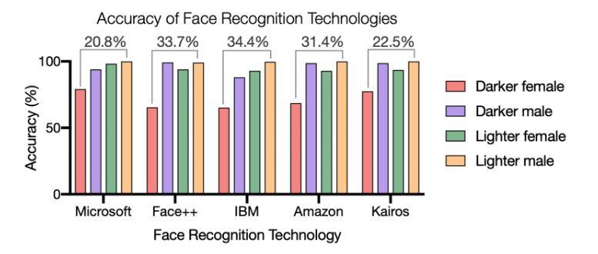
Facial recognition
Racial Discrimination in Face Recognition Technology, By Alex Najibi, 24.10.2020, visited 19.03.2024
https://sitn.hms.harvard.edu/flash/2020/racial-discrimination-in-face-recognition-technology/

Slide 14
Facial recognition
Williams, Oliver, Parks
wrongfully identified & arrested
2019 – 2020
Uber using selfies to register for jobs
Manjang faced “continued mismatches”
locked out 2021
How Wrongful Arrests Based on AI Derailed 3 Men's Lives,
By Khari Johnson, 07.03.2022, visited 19.03.2024
https://www.wired.com/story/wrongful-arrests-ai-derailed-3-mens-lives/
Payout for Uber Eats driver over face scan bias case,
By Shinoa McCallum, 26.03.2024, visited 28.03.2024
https://www.bbc.com/news/technology-68655429

Slide 15
Facial recognition
Testing inaccuracies
Minorities and women badly covered
Racial discrimination in law enforcement
mug shots to identify individuals
feed-forward loop
Lack of consent & transparency
Tool https://haveibeentrained.com/
Mass surveillance
Ethics of Facial Recognition: Key Issues and Solutions
By Katam Raju Gangarapu, 25.01.2022, visited 19.03.2024
https://learn.g2.com/ethics-of-facial-recognition
Notes:
a slight change in camera angle or appearance, such as a new hairstyle, can lead to errors

Slide 16
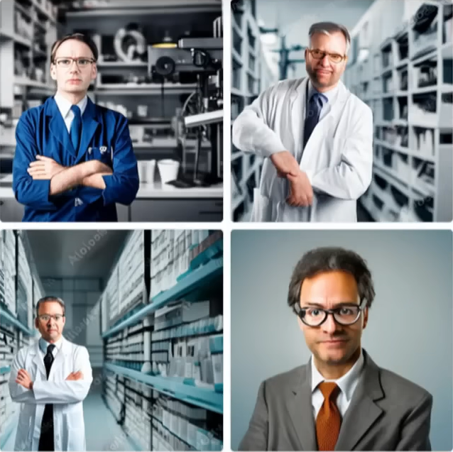
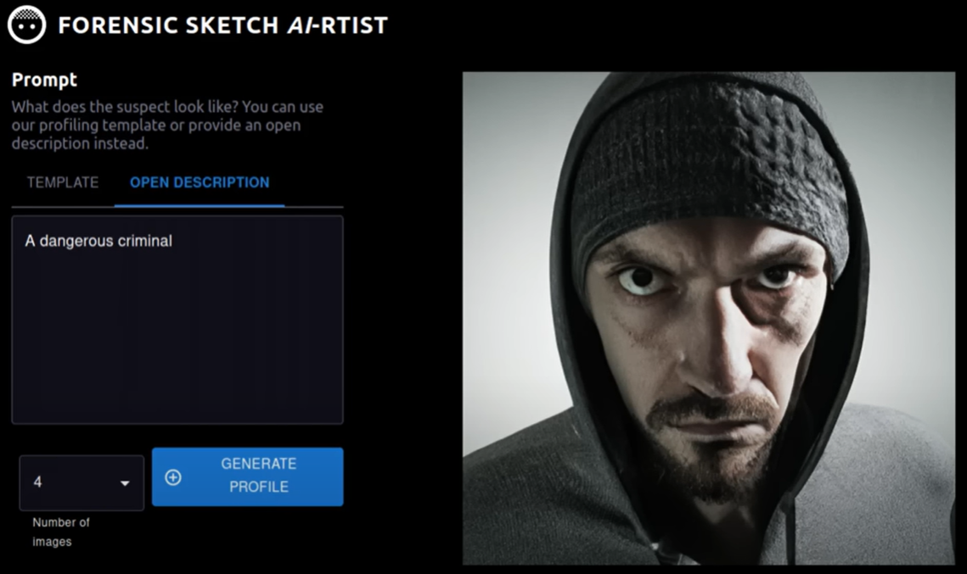
Bias
Images from:
AI Is Dangerous, but Not for the Reasons You Think | Sasha Luccioni | TED
https://www.youtube.com/watch?v=eXdVDhOGqoE
Notes:
a slight change in camera angle or appearance, such as a new hairstyle, can lead to errors
wrongful identification
image generation shows stereotypes and bias
“dangerous criminal” vs
“scientist/ lawyer/ CEO”
DiffusionBiasExplorer
https://huggingface.co/spaces/society-ethics/DiffusionBiasExplorer
DiffusionBiasExplorer
https://huggingface.co/spaces/society-ethics/DiffusionBiasExplorer

Slide 17
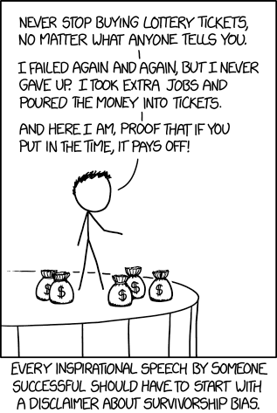
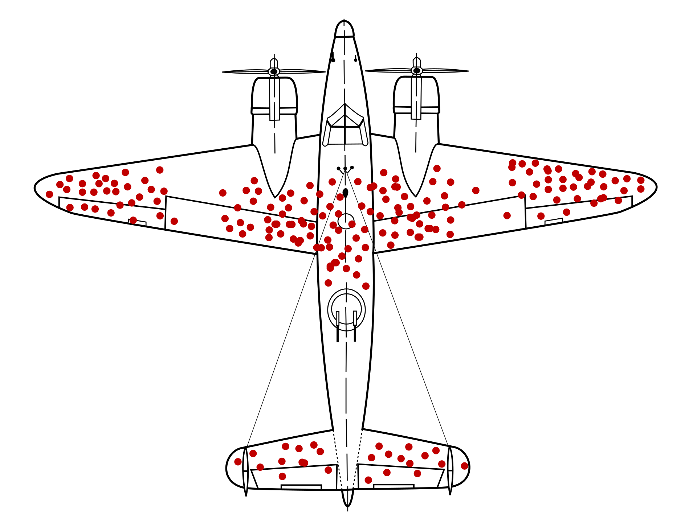
Survivorship Bias
Positive results are overly present / give a false picture
Military
AI
Certain data overrepresented
→ “full picture” rarely present
https://en.wikipedia.org/wiki/Survivorship_bias
https://xkcd.com/1827/

Slide 18
Bias – challenges
Healthcare
Applicant tracking systems
Advertisement
Predictive policing
Tool recommendation: https://huggingface.co/spaces/society-ethics/DiffusionBiasExplorer
Insight - Amazon scraps secret AI recruiting tool that showed bias against women
By Jeffrey Dastin, 11.10.2018, visited 19.03.2024
https://www.reuters.com/article/idUSKCN1MK0AG/
Shedding light on AI bias with real world examples
By IBM Data and AI Team, 16.10.2023, visited 19.03.2024
https://www.ibm.com/blog/shedding-light-on-ai-bias-with-real-world-examples/
Notes:
Healthcare
computer-aided diagnosis systems have return lower accuracy results
Applicant tracking systems
It penalized resumes that included the word "women's," as in "women's chess club captain." And it downgraded graduates of two all-women's colleges, according to people familiar with the matter.
Amazon stopped using a hiring algorithm after finding favoring of certain terms
“executed” or “captured,”
Advertisement
High paying jobs only being shown to specific groups
Predictive policing
Identification of areas with high level of crime

Slide 19
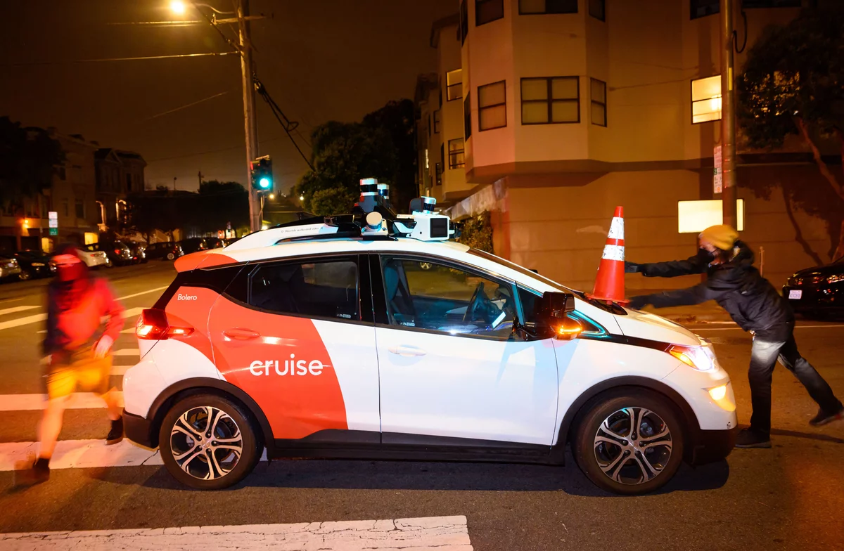
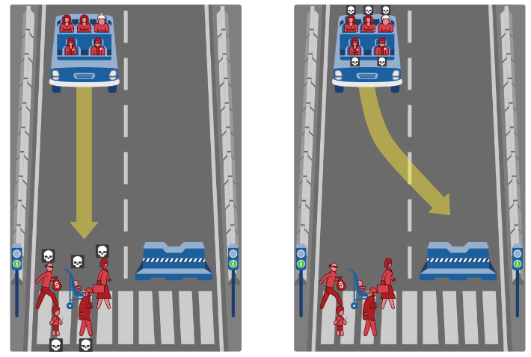

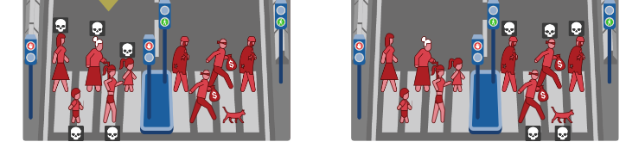
Self driving cars
Who decides?
Who is liable?
The dev? The driver? The OEM?
What if the driver has his hands on the wheel?
What happens in a hack incident?
Members of Safe Street Rebel place a cone on a self-driving Cruise car in San Francisco.
Josh Edelson/AFP via Getty Images
https://www.moralmachine.net/

Slide 20
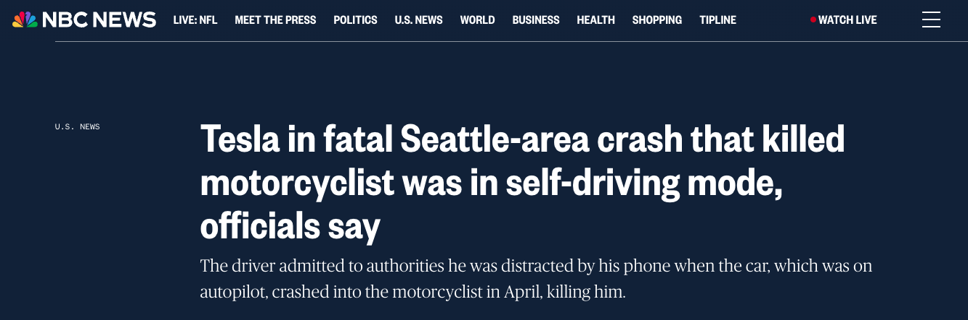
Self driving cars
vehicle was in "Tesla’s Full Self-Driving (Supervised) mode
Driver arrested on suspicion of vehicular homicide
Not officially charged… yet?
https://www.nbcnews.com/news/us-news/tesla-fatal-seattle-area-crash-killed-motorcyclist-was-self-driving-mo-rcna164488
Notes:
The driver of the Tesla told police he had activated the autopilot system and was relying on it to operate the car at the time of the accident.
He recalled being alerted to the crash only by the sound of the collision.
Tesla says its "Full Self-Driving (Supervised)" software requires active driver supervision and does not make vehicles autonomous.

Slide 21
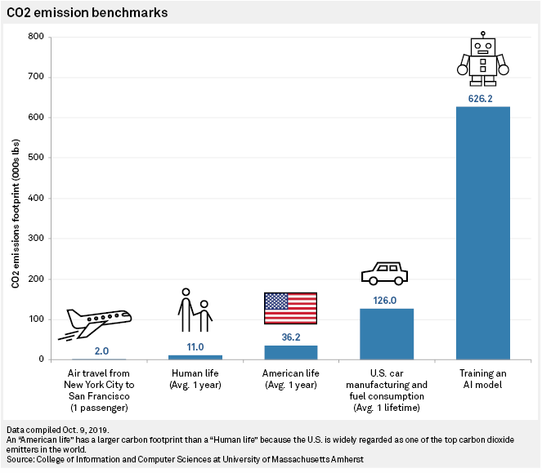
Sustainability
Training GPT-3 502 tons of CO2
Carbon footprint ~8.4 tons of CO2 a year
CO2 emission tracking for python: https://codecarbon.io/
https://www.spglobal.com/marketintelligence/en/news-insights/trending/HyvwuXMO9YgqHfj7J6tGlA2
Notes:
training process can emit over 626,000 pounds of carbon dioxide, nearly 5x the lifetime emissions of an average car, or the equivalent of about 300 round-trip flights between New York and San Francisco.

Slide 22
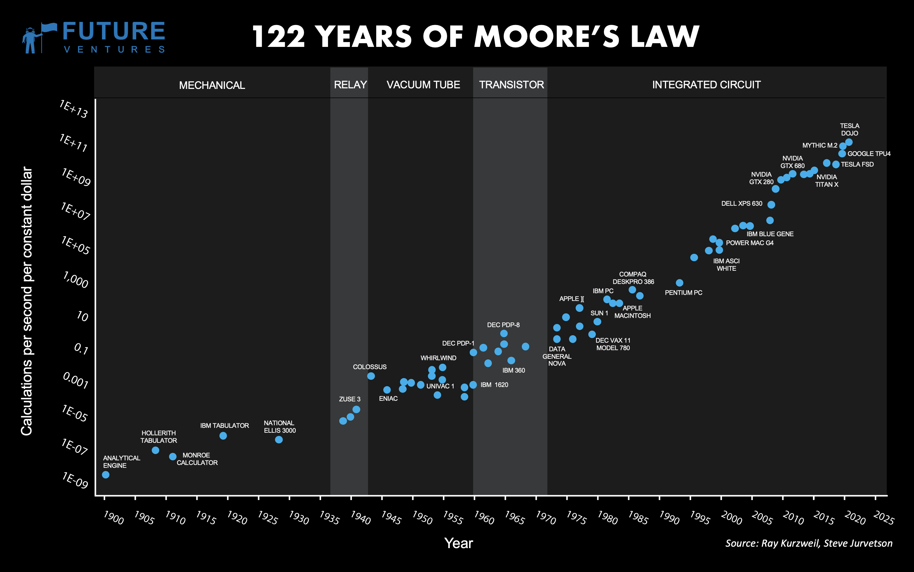
https://news.climate.columbia.edu/2023/06/09/ais-growing-carbon-footprint/
Notes:
Moore's law is the observation that the number of transistors in an integrated circuit (IC) doubles about every two years.
Observation and projection of a historical trend.
In 2021, global data center electricity was about 0.9 to 1.3 percent of global electricity demand.
increase to 1.86 percent by 2030.
energy consumption of data centers on the European continent will grow 28 percent by 2030.

Slide 23
Sustainability
Model
efficient ML model architectures → reduce computation by 3x–10x
Machine
processors and systems optimized for ML training → improve performance and energy efficiency by 2x–5x
Mechanization
Computing in Cloud rather than on premise → reduces energy usage by 1.4x–2x
Map Optimization
location with the cleanest energy → reduce the gross carbon footprint by 5x–10x
https://blog.research.google/2022/02/good-news-about-carbon-footprint-of.html

Slide 24
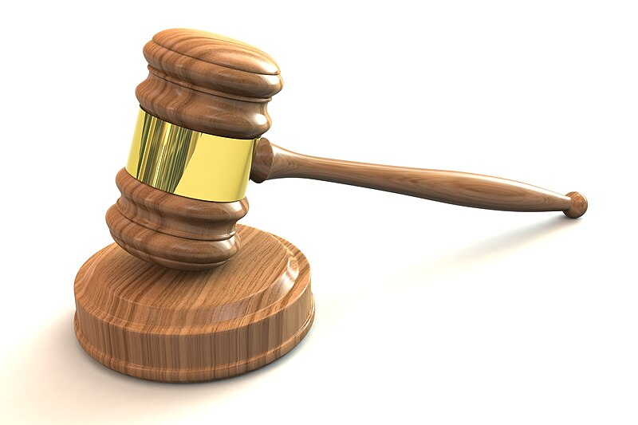
How can tackle these challenges?
3D Judges Gavel, By Chris Potter
https://commons.wikimedia.org/wiki/File:3D_Judges_Gavel.jpg

Slide 25
Facial recognition
San Francisco banned the usage of FR
2019
Facial Recognition and Biometric Technology Moratorium Act
2023
Federal blueprint for an AI bill of rights
2022
Nonbinding
San Francisco Bans Facial Recognition Technology, By Kate Conger, Richard Fausset and Serge F. Kovaleski, 14.02.2019, visited 19.03.2024
https://www.nytimes.com/2019/05/14/us/facial-recognition-ban-san-francisco.html
MARKEY, MERKLEY, JAYAPAL LEAD COLLEAGUES ON LEGISLATION TO BAN GOVERNMENT USE OF FACIAL RECOGNITION AND OTHER BIOMETRIC TECHNOLOGY, Press release, 07.03.2023, visited 19.03.2024
https://www.markey.senate.gov/news/press-releases/markey-merkley-jayapal-lead-colleagues-on-legislation-to-ban-government-use-of-facial-recognition-and-other-biometric-technology
Blueprint for an AI Bill of Rights,
The white house, 2022, visited 19.03.2024
https://www.whitehouse.gov/ostp/ai-bill-of-rights/
Notes:
Research shows nearly half of U.S. adults’ faces exist in facial recognition databases and that the faces of Black, Brown, and Asian individuals are up to 100 times more likely to be misidentified than white male faces.

Slide 26
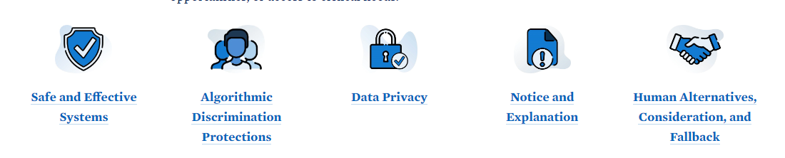
AI bill of rights
Blueprint for an AI Bill of Rights,
The white house, 2022, visited 19.03.2024
https://www.whitehouse.gov/ostp/ai-bill-of-rights/
Protection from unsafe or ineffective systems
systems should be used and designed in an equitable way. Algorithms should not discriminate
Protection from abusive data practices via built-in protections should exists. You should have agency over how data about you is used
Knowledge about when an automated system is being used. Transparency on how and why it contributes to outcomes that impact you
Option to opt out, where appropriate. Access to a person who can quickly consider and remedy problems you encounter
Notes:
Equitable = gerecht

Slide 27
EU regulation – AI act
EU study sees serious threat to civil liberties
“risk of algorithmic error is high”
EU classifies AI according to risk
Category -> regulation
ban of “unacceptable” risk
social scoring
exploiting vulnerabilities due to age, disability
biometric categorization inferring sensitive attributes
inferring emotions in workplaces or educational institutions
Facial recognition databases through untargeted scraping from CCTV/ internet …
Artificial Intelligence Act: MEPs adopt landmark law
EU press release, 13.03.2024, visited 19.03.2024
https://www.europarl.europa.eu/news/en/press-room/20240308IPR19015/artificial-intelligence-act-meps-adopt-landmark-law
High-level summary of the AI Act
27 02.2024, visited 08.09.2024 https://artificialintelligenceact.eu/high-level-summary/
Notes:
biometric categorisation systems inferring sensitive attributes (race, political opinions, trade union membership, religious or philosophical beliefs, sex life, or sexual orientation), except labelling or filtering of lawfully acquired biometric datasets or when law enforcement categorises biometric data.

Slide 28
EU regulation – AI act
Exemptions for law enforcement
Only for defined list of crime and limited time & location
Biometric identification only allowed in targeted search of a convicted or suspect of a serious crime
Obligations for high-risk systems
E.g., crit infrastructure, education, public services like banking and healthcare
Complaint process and right to receive explanations about decisions based on AI systems
Transparency requirements
With training data
Model evaluations & incident reporting
Labelling of artificial images, audio, video
Artificial Intelligence Act: MEPs adopt landmark law
EU press release, 13.03.2024, visited 19.03.2024
https://www.europarl.europa.eu/news/en/press-room/20240308IPR19015/artificial-intelligence-act-meps-adopt-landmark-law
https://artificialintelligenceact.eu/de/
Artificial Intelligence Act: deal on comprehensive rules for trustworthy AI
EU press release, 09.12.2023, visited 19.03.2024
https://www.europarl.europa.eu/news/en/press-room/20231206IPR15699/artificial-intelligence-act-deal-on-comprehensive-rules-for-trustworthy-ai
Notes:
RBI = remote biometric identification
for the purposes of:
targeted searches of victims (abduction, trafficking, sexual exploitation),
prevention of a specific and present terrorist threat, or
the localisation or identification of a person suspected of having committed one of the specific crimes mentioned in the regulation (e.g. terrorism, trafficking, sexual exploitation, murder, kidnapping, rape, armed robbery, participation in a criminal organisation, environmental crime).

Slide 29
EU regulation – AI act
EU study sees serious threat to civil liberties
“risk of algorithmic error is high”
EU regulates & bans AI that does…
13.03.2024
Biometric categorization
Untargeted scraping of facial images from the internet & CCTV for FRT databases
Emotion recognition in workplace, education environment
social scoring
Manipulation of human behavior/ exploits people
…
Artificial Intelligence Act: MEPs adopt landmark law
EU press release, 13.03.2024, visited 19.03.2024
https://www.europarl.europa.eu/news/en/press-room/20240308IPR19015/artificial-intelligence-act-meps-adopt-landmark-law
https://artificialintelligenceact.eu/de/
Artificial Intelligence Act: deal on comprehensive rules for trustworthy AI
EU press release, 09.12.2023, visited 19.03.2024
https://www.europarl.europa.eu/news/en/press-room/20231206IPR15699/artificial-intelligence-act-deal-on-comprehensive-rules-for-trustworthy-ai

Slide 30
EU regulation – AI act
Exemptions for law enforcement
Only for defined list of crime and limited time & location
Biometric identification only allowed in targeted search of a convicted or suspect of a serious crime
Obligations for high-risk systems
E.g., crit infrastructure, education, public services like banking and healthcare
Complaint process and right to receive explanations about decisions based on AI systems
Transparency requirements
With training data
Model evaluations & incident reporting
Labelling of artificial images, audio, video
Artificial Intelligence Act: MEPs adopt landmark law
EU press release, 13.03.2024, visited 19.03.2024
https://www.europarl.europa.eu/news/en/press-room/20240308IPR19015/artificial-intelligence-act-meps-adopt-landmark-law
https://artificialintelligenceact.eu/de/
Artificial Intelligence Act: deal on comprehensive rules for trustworthy AI
EU press release, 09.12.2023, visited 19.03.2024
https://www.europarl.europa.eu/news/en/press-room/20231206IPR15699/artificial-intelligence-act-deal-on-comprehensive-rules-for-trustworthy-ai
Notes:
RBI = remote biometric identification
for the purposes of:
targeted searches of victims (abduction, trafficking, sexual exploitation),
prevention of a specific and present terrorist threat, or
the localisation or identification of a person suspected of having committed one of the specific crimes mentioned in the regulation (e.g. terrorism, trafficking, sexual exploitation, murder, kidnapping, rape, armed robbery, participation in a criminal organisation, environmental crime).

Slide 31
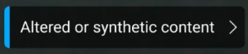
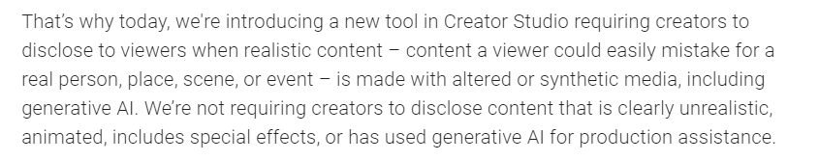
AI content Youtube
How we're helping creators disclose altered or synthetic content
The youtube team, 18.03.2024, visited 19.03.2024
https://blog.youtube/news-and-events/disclosing-ai-generated-content/

Slide 32
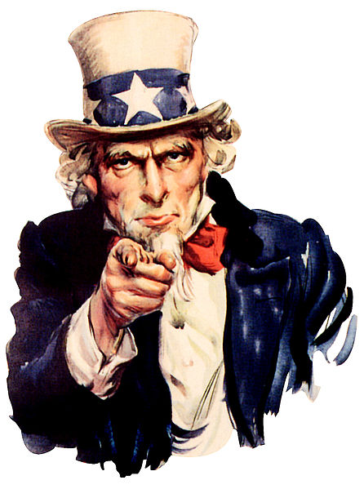
Challenges solved?
Companies
Guidelines for AI usage
AI labels
Legislature
Laws & guidelines
EU AI Act
AI bill of rights
…
Tools
https://en.wikipedia.org/wiki/Americans

Slide 33
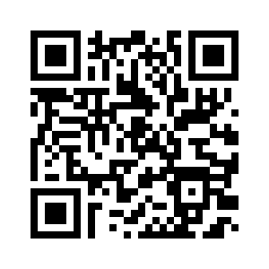
Q & A
Questions to ask yourself
What data is used in training?
Who is liable for the AI’s behavior?
Is the decision-making process transparent?
Is the AI good and fair for everyone?
Is the AI sustainable?
How can we ensure this?
Companies enforce this
Law making – e.g., EU & US ban on facial recognition
A lot more on this topic…
European Parliamentary Research Service list on AI https://epthinktank.eu/tag/artificial-intelligence/
https://artificialintelligenceact.eu/
Moritz Christopher Schmidt - AI Ethics in Software Engineering
Notes:
tsa 2024 face recognition
opt in
law of generated images
apple ai, google a

Slide 34
What is AI?
Turing test – Alan Turing 1950
Logic theorist – Newell, Simon, Shaw 1956
https://en.wikipedia.org/wiki/Turing_test
1950
Notes:
Logic Theorist: one of the earliest AI programs. It could prove mathematical theorems. Explored a search tree – in the tree is the goal, path to goal is the proof

Slide 35
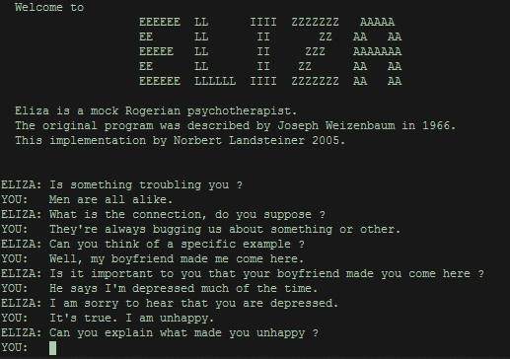
What is AI?
Eliza – Weizenbaum 1966
Expert system Mycin – Stanford 1972
~ 600 rules
https://en.wikipedia.org/wiki/ELIZA
1950
1970
Notes:
MYCIN: expert system to identify bacteria causing severe infections, such as bacteremia and meningitis, and recommend antibiotics, with dosage adjusted for patient's body weight
ELIZA: natural language processing program that simulated conversation. It provided simple responses based on pattern matching.

Slide 36
What is AI?
Deep Blue – IBM 1997
Chess AI
NaturallySpeaking – Dragon Systems 1997
Speech recognition
1950
1970
1990
Notes:
IBM Deep Blue: defeated world chess champion Garry Kasparov in a six-game match, demonstrating the power of AI in strategic decision-making.
->calculated all paths to play, numbers of paths limited
Dragon Systems: speech recognition software for dictation and command recognition, enabling users to interact with computers using voice commands
Akustischen Signale zur Umsetzung digital abgetastet und im Rahmen eines „akustischen Modells“ nach Charakteristika eingeordnet, die eine ungefähre Zuordnung zu Lauten ermöglichen. Die Auswahl erfolgt statistisch unter Einsatz verschiedener Varianten von Hidden-Markov-Modellen.

